Slide 1
Set of techniques and technologies
applied in a
Google Cloud Platform environment
to maintain multiple geospatial oriented projects keeping an eye on
sustainability, maintainability, reliability, limitations and ... “best practices” :)
Carlo Cancellieri
geo.ccancellieri@gmail.org

Slide 2
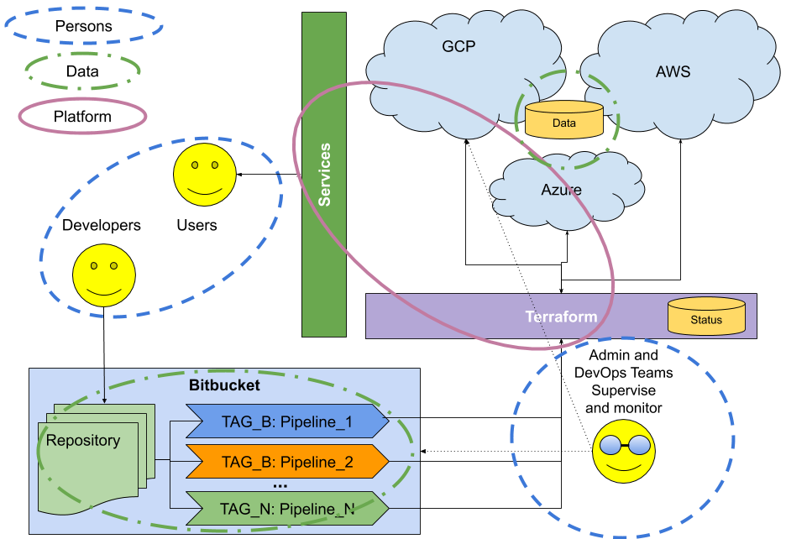
Environment
Actors (in order)
Persons
Data
Platform
Integrations
Integration is the key to success. Well defined, standard layers, interfaces and FEW CLEAR conventions
Tracking changes
Changes might be documented to share the knowledge of the status of the platform
Testers

Slide 3
Users
Open
Most of the services are open to read and write (for authenticated users)
We’re providing accounts automatically/on demand*
Changes are usable in stories in few minutes
Easy
All the services are standard and documented by the community
It’s easy to use well known tools like Qgis, ArcGis or GEE*
Integrated
We are not forcing users to work with specific tools
we are *working to integrate more Open Source tools and protocols (f.e. WPS)
but also to provide integrations with GEE and much more*
Accessible, stable and Integrated
Users

Slide 4
Team / DevOps
Development might not affect the DevOps team activities
for this reason (and many more)
environments (gcp projects) are well separated
Pair sessions, knowledge sharing
DevOps
Activities over Review are safe (by design)
No need to ask for delivery
[but let’s keep DevOps informed]
It’s easy to deploy and test autonomously
[deploy from scratch
then
destroy all to save resources]
Activities over Production must be supervised
Dedicated projects (or branches)
MUST be authorized and performed in a PAIR SESSION with a DevOps responsible
[to share the knowledge and avoid mistakes]

Slide 5
Team / Testers
Unidirectional
New features are delivered in Review, tested then, ported* to Production
Test driven
Every* time a migration from Review to Production is performed a full coverage set of tests is performed over the services (Jmeter, other, ...)
Continuous Testing
Pipelines* for continuous testing
Fail fast, F.i.r.s.t. principles: Fast, Isolated/Independent, Repeatable, Self-validating, Timely
Testers

Slide 6
Team / Developers
Independent release cycles for
the Solution(s)
and
the Product(s)
Well* defined and extensible* interface
between Product(s) and IAC project (Solution)
Continuous Integration pipelines
Decoupled, Isolated, Maintainable
Developers

Slide 7
Data protection
Unidirectional flow from Review to Production,
from Primary (master) to Secondary instances (slaves)
Experiments are performed over a copy in Review then Replicated in Production
[once the procedure is clear]
Automatic scheduled backup up to 14 days [Disks and Database]
Rollback ready: it's easy [in emergency] to
create a temporary machine serving data from a previous backup
Data: Unidirectional flow, clear workflow, versioning, fast recovery

Slide 8
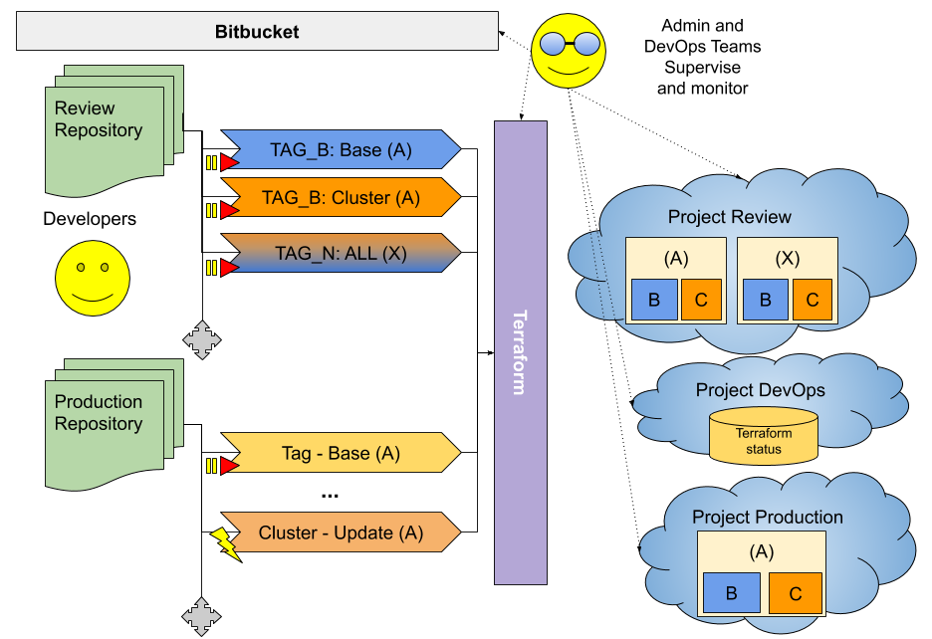
Platform
Immutabile - Reproducible
Using tags any (infrastructure) release is reproducible
Modular
All the (Terraform) modules are intentionally generic, it's simple to reuse them
Maintainable
Easy to create/upgrade thanks to the automatic propagation. Destroy will easily take care of cleanup (in Review).
Scalable
Designed to automatically scale up and down to N+1 instances to support up to thousands of requests per minute.

Slide 9
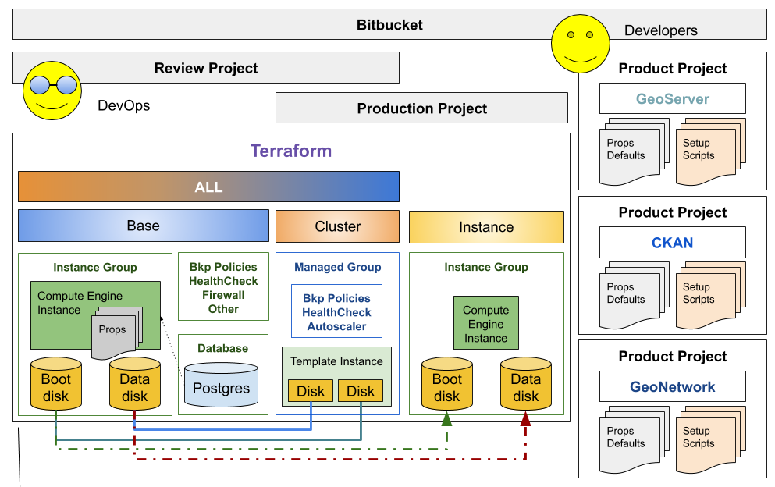
Modularization and packaging
Plugins
Terraform Modules
Impl.
Integrated Products
IAC Solutions

Slide 10
Products and Solutions

Slide 11
Delivery, Deploy, Test
Continuously
Product
Project
Artifact
Repository
Delivery Pipeline
Destroy
Fetch
IAC
Project
GCP
Deployment Pipeline
Test
Integration Pipeline
*

Slide 12
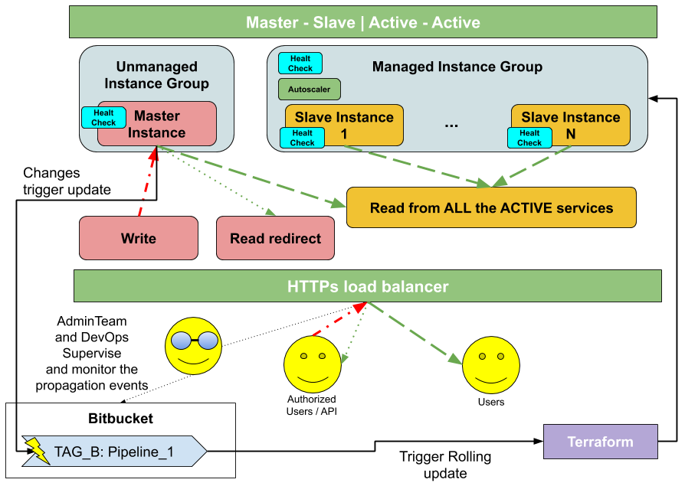

Slide 13
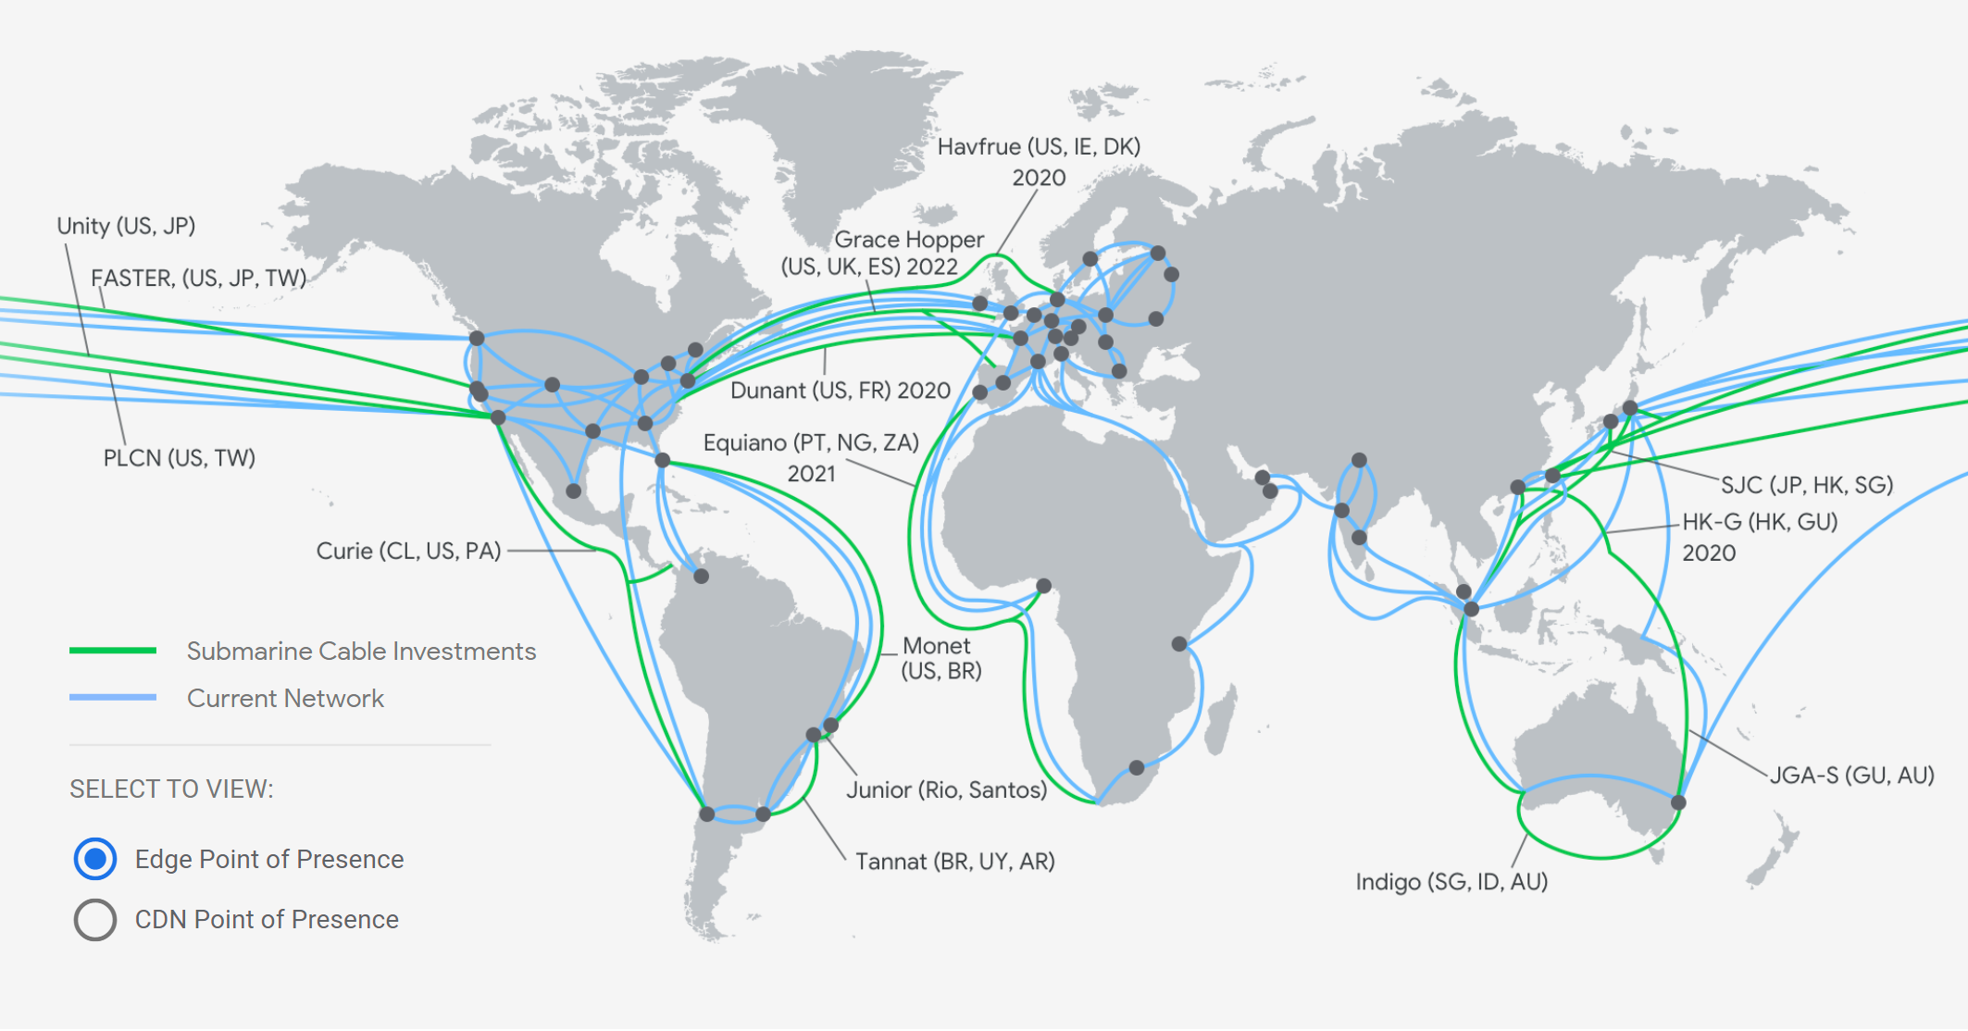
Why propagation:
Cloud Ready
Reduce latency
Improve availability
Better to have a Replica
Master
Managed Instance Group
Load Balancer
Google Cloud Inter Region Latency
Google Cloud supports 18 regions for its cloud services. Understanding latency between the regions is important as performance starts to have noticeable degradation when the latency is more than 150 - 200ms between a client and server or between two servers in two different regions.

Slide 14
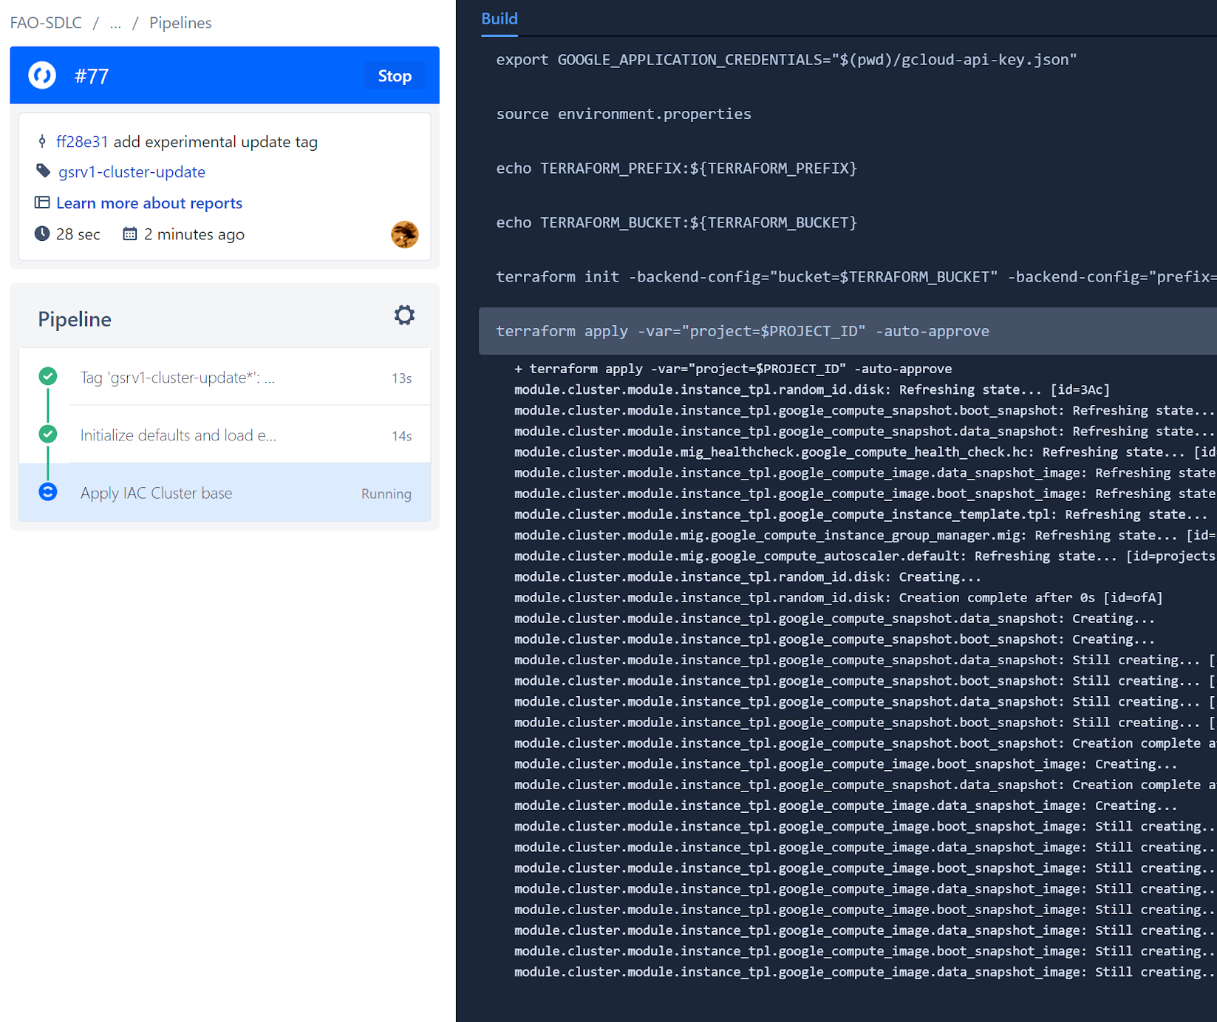
Keeping secondary groups up to date (over regions)
Upload pipeline is triggered from the master instance each 30 minutes (if a configuration or data change is detected).
Thanks to Terraform it provides:
new Instance template
attaching fresh disks copy and policies
triggers the rolling update on the managed instance group
outdated disks and templates cleanup

Slide 15
Questions?

Slide 16
Want more?
The following slides will clarify some important details over the internal mechanisms of the Product projects
Internal documentation is provided inline in the code
Developers

Slide 17
Product Projects:
Each release is made to configure a Debian/Ubuntu vanilla image from scratch providing a fully working and connected (to disks and database) running instance of:
[Debian] GeoServer
[Ubuntu] CKAN
[Debian] GeoNetwork
CI/CD Pipelines:
Each product project produces 2 artifacts:
setup.sh
resources.tar.gz
These artifacts are deployed at each commit over the $RELEASE google bucket
The release also provides some overrides for the incoming customization variables (Terraform) such as:
Context path to expose the web service (/path/to/context)
List of plugins to install (several)
Ancillary files to configure plugins (several)
Other optimizations (JVM, Connection pools, memory usage, etc)

Slide 18
Compute Instance:
OnShutdown:
[log_process.sh] Collect logs and backup in a tarball over a bucket
[audit_process.sh] Backup all the pending monitoring (requests) logs over a bucket
Daily:
[audit_process.sh] Backup all the incoming requests logs over a bucket
OnStartup:
[startup-script.sh] Run:
Source environment variables
download fresh Setup.sh from the $RELEASE bucket
Run Setup.sh
On [Setup.sh]:
Download fresh resources.tar.gz
If lock files are present, no action is performed
Lock files to prevent further execution on boot
Install system software checking for errors
If requested initialize the disk and add to mount
If requested initialize DB and change password
Update/install GeoServer/CKAN/GeoNetwork
Main (Master) instance:
Each half hour:
[run_tag.sh] Run the smart script to check for changes.
If an update is found a pipeline trigger event is fired to propagate changes.
Secondary (Slave) instance:
OnStartup:
[startup-script.sh] Run:
initialize environment variables
download fresh Setup.sh from the $RELEASE bucket
Run Setup.sh [normally no action is performed if lock files are present]
Initialize crontab to removing run_tag.sh execution to avoid duplicate execution

Slide 19
Thank you
Carlo Cancellieri
geo.ccancellieri@gmail.org

